Slide 1
Problem Identification
What are ways that Big Mountain Resort can restructure its ticket price for next season to reflect the value of its facilities while remaining competitive within the market segment?

Slide 2
Recommendation & Key Findings
Big Mountain’s current ticket price of $81.00 is undervaluing its facilities compared to other resorts in the same market
To strictly cover the increase in operating costs of the new chair lift, Big Mountain would need to raise the ticket price to $82.00
Increasing Big Mountain’s vertical drop is the best investment for increasing revenue through ticket prices

Slide 3
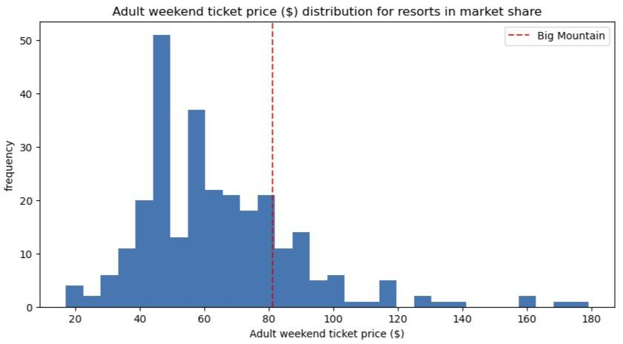
Modeling Results & Analysis
The modeled ticket price for Big Mountain is $95.87 (MAE is $10.39)
Model results suggest there is room for an increase in ticket price
Caution
Model assumes other resorts are accurately setting price based on value of facilities
Operating costs may need to be considered in model

Slide 4
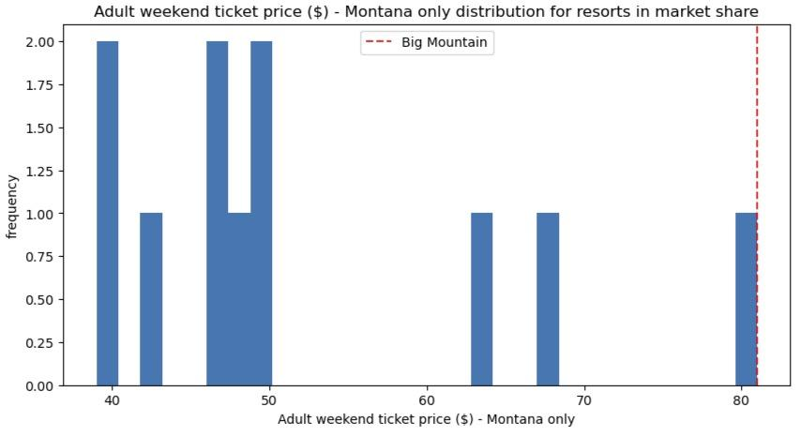
Modeling Results & Analysis
Big Mountain is on the upper end of ticket price for Montana resorts
Risk of pricing Big Mountain out of local market with price increase
Where are visitors from?
If local, then real risk of losing visitors to other MT resorts
If remote, then risk is reduced as facilities are driving business (not convenience)

Slide 5
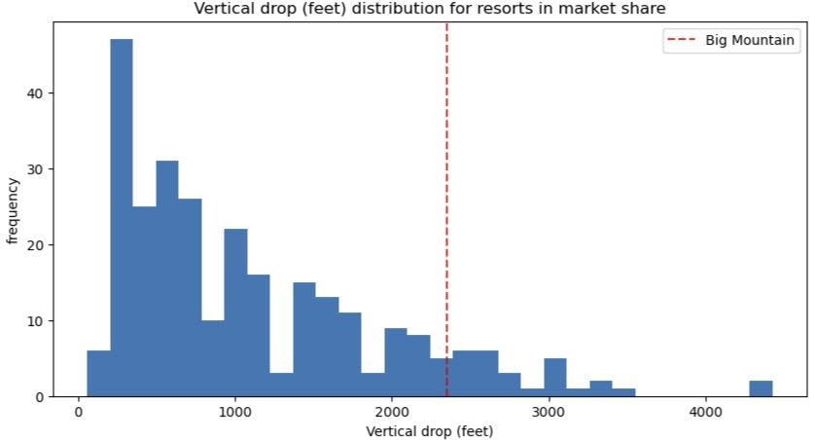
Modeling Results & Analysis
Big Mountain is doing well for vertical drop, but still quite a few resorts have greater drop
Increasing vertical drop by 150 feet (scenario 2 of investment proposal)
$1.99 increase in ticket price
$3,474,678 increase in yearly revenue

Slide 6
Summary & Conclusion
Big Mountain’s current ticket price of $81.00 appears to be undervaluing its facilities
Raising cost to $82.00 would cover the operating costs of new chair lift
Model-predicted ticket price for Big Mountain: $95.87
Other key features (like operating cost) need to be considered for model
Origin of Big Mountain’s visitors needs further examination
Increasing Big Mountain’s vertical drop is the best investment for increasing revenue through ticket prices

